Slide 1
DC COURSE PROJECT
Team Member
Ananth Choudhary
Aditya Phatak
Shreyas Mutnal
Lokesh Pandey

Slide 2
Problem Statement Design & Implement a digital system using suitable logic for scoreboard monitoring system for cricket.
FEATURES AND SPECIFICATIONS GIVEN
Touch / Switch based input -> Switch
Option for type of game -> Cricket
Digital Display -> CA

Slide 3
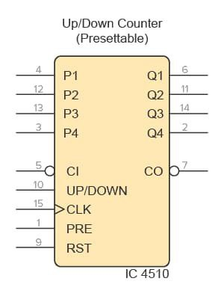
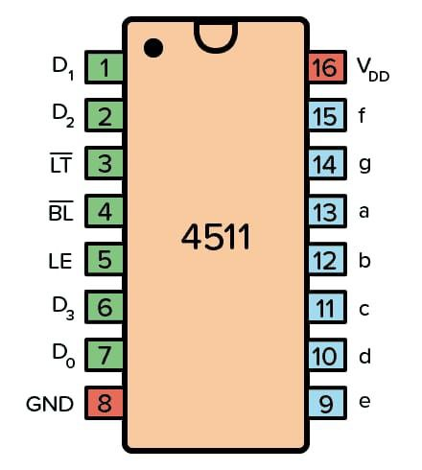
Components used
IC 4511
IC 4510

Slide 4
About 4510
The CD4510 is an up/down BCD counter that you can preset. Since the output is in BCD format, it means it counts from 0 up to 9 only. Unlike its brother, the CD4516, that counts from 0 to 15. The counter value is given in binary, so for example a ‘5’ would be output as 0101:
Q4=LOW
Q3=HIGH
Q2=LOW
Q1=HIGH
Every time the clock pin goes from low to high, the output increases or decreases by 1, depending on the state of the UP/DOWN pin. The counter can be preset to any value that is present on pins P1 to P4 by setting the PRE pin to HIGH.

Slide 5
About 4511
The CD4511 is a BCD to 7-segment decoder. It means it takes a number in binary form as an input, then displays this number on a 7-segment display using its outputs.
A 7-segment display is a component with seven Light-Emitting Diodes (LED) arranged as shown below. By turning on different combinations of the LEDs, a number between 0 and 9 is displayed.

Slide 6
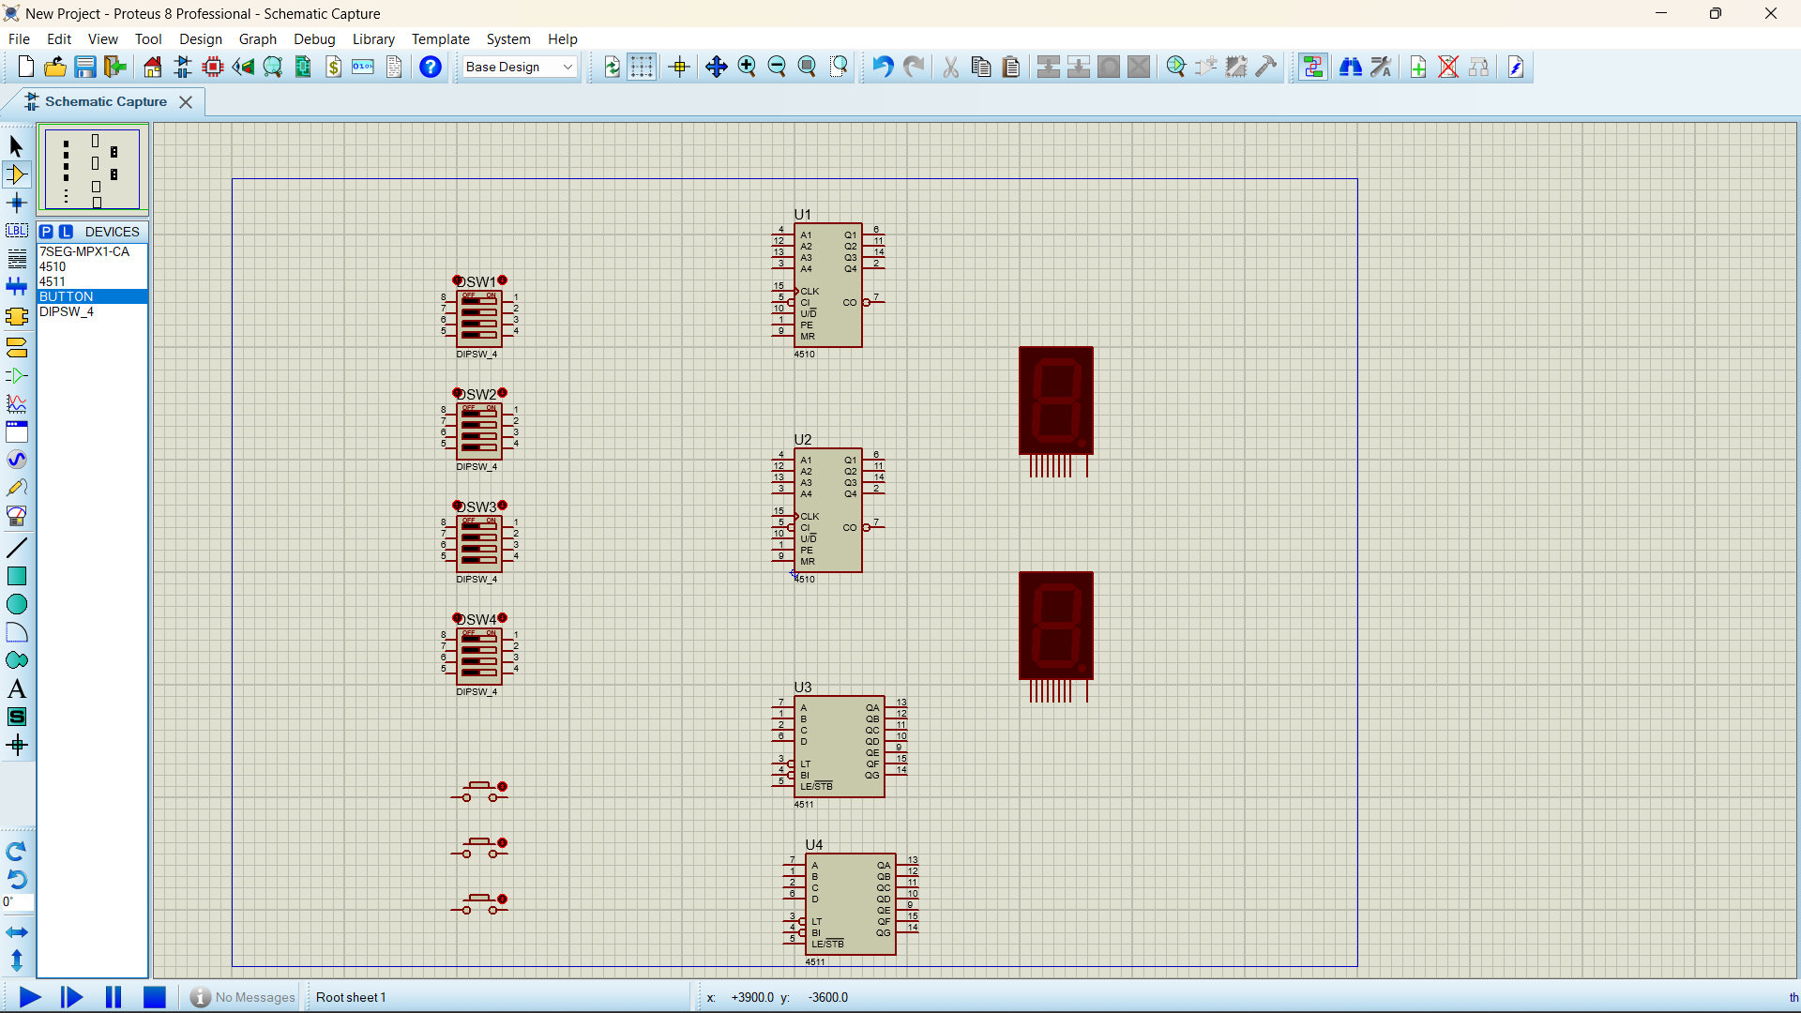
Components used
Understanding the problem statement :
We need to design a scoreboard monitoring system for cricket with switch-based input & common anode digital display.
We assume that no team is scoring beyond 99 runs

Slide 7
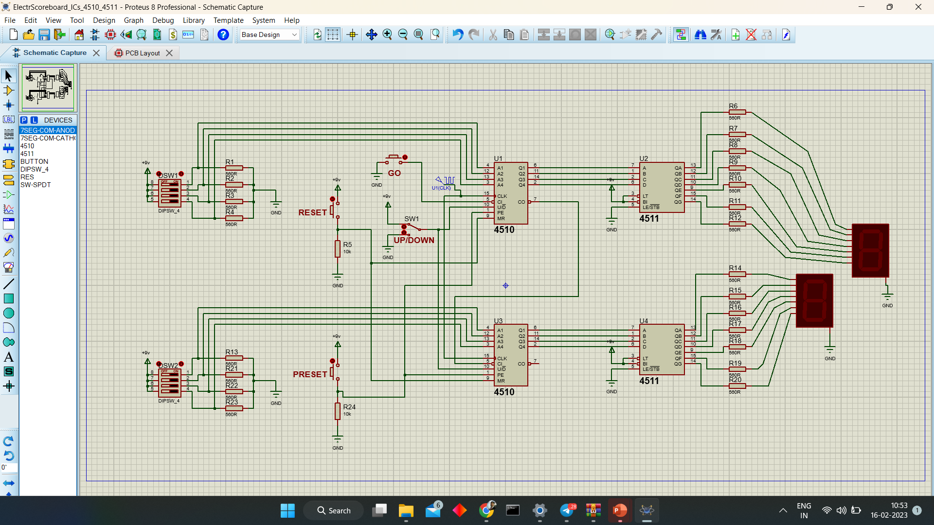
Design of the circuit

Slide 8
Thank you

